Slide 1
Welcome!
Question of the Day:
SXSW Free:
Vallejo, Wednesday, Auditorium Shores
‹#›

Slide 2
7.2 Array Traversal Algorithms
7.3 Reference Semantics
PROFESSOR RAMSEY
GDC 6.318
ramsey@cs.utexas.edu
Notes:
CHANGE - add slides showing memory stacks

Slide 3
Announcements
Remember Mid-Semester Survey quiz

Slide 4
7.1 Quiz

Slide 5
Catch Up
Slide 27+

Slide 6
7.2
Array Traversal Algorithms

Slide 7
In-Class Practice
Design
calling code:
output:
intsEqual() - determine if two integer arrays have identical contents.
if sizes of arrays aren’t equal, return false
for each index array1
if items in each array at index aren’t equal, return false
return true

Slide 8
In-Class Practice
Code
calling code:
output:
Method: intsEqual(), works with calling method above
Purpose: determine if two integer arrays have identical contents.
Parameters: two integer arrays
Return: True if arrays have equal content, otherwise false
(Imagine Array.equals() doesn’t exist.)

Slide 9
Solution

Slide 10
In-Class Practice
Design
original array:
reversed array:
[0] | [1] | [2] | [3] | [4]
56 | 11 | -45 | 0 | 8
[0] | [1] | [2] | [3] | [4]
8 | 0 | -45 | 11 | 56
reverseArray() - reverse order of items in an array
start - 0, end - length - 1
loop size / 2 times
swap start and end
start ++, end – –

Slide 11
In-Class Practice
Code
calling code:
output:
Method: reverseArray(), works with calling method above
Purpose: determine if two integer arrays have identical contents.
Parameters: two integer arrays
Return: True if arrays have equal content, otherwise false
(Imagine Array.equals() doesn’t exist.)

Slide 12
Solution

Slide 13
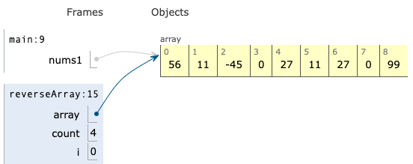
Just in - Memory News
Inside the reverseArray() method:
After the reverseArray() method returns:

Slide 14
7.3
Reference Semantics

Slide 15
Demo
Demo 1
What is happening?

Slide 16
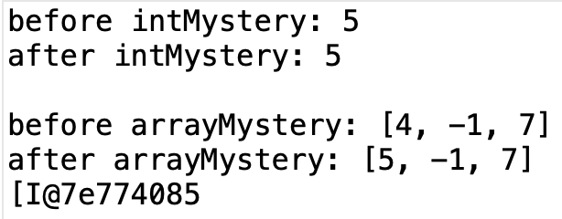
Demo Code and Output

Slide 17
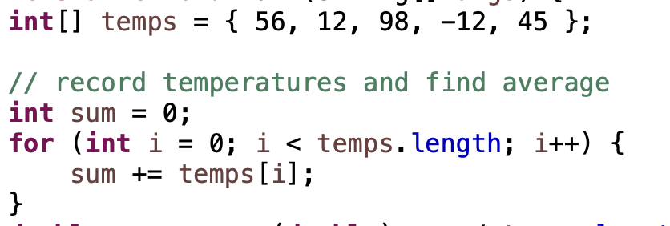
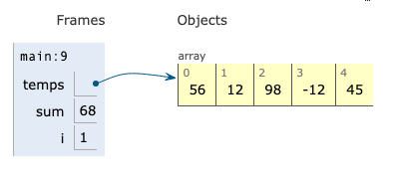
Python Tutor

Slide 18
Value Semantics
value semantics: Behavior where values are copied when assigned, passed as parameters, or returned.
Used by primitive types (and Strings).
When one variable is assigned to another, its value is copied.
Modifying the value of one variable does not affect others.
When a variable is sent to a method as a parameter, the method works with a copy and the original variable doesn’t change.
Variable names can be the same or different, no difference.
copy
Changes made here don’t go back to main().
When method is done, this memory is released.
main()
x | 5
intMystery()
x | 5

Slide 19
Reference Semantics
reference semantics: Behavior where variables store the address of an object in memory. Only one copy. CHANGE HAPPENS.
Used by objects (but not Strings).
When one variable is assigned to another, the object is not copied; both variables refer to the same object.
Modifying the value of one variable will affect others.
Variable names can be the same or different, no difference.
main()
nums | [I@7e774085
arrayMystery()
nums | [I@7e774085
Object Space
[I@7e774085 | [4, -1, 7]

Slide 20
Objects Use Reference Semantics
Why?
Efficiency - Objects are larger than primitive types. Copying large objects slows down a program.
Sharing - It's useful to share an object's data among methods.
When objects are sent as parameters, the changes will be seen by the calling method.
public static void main(String[] args) {
DrawingPanel window = new DrawingPanel(80, 50);
window.setBackground(Color.YELLOW);
example(window);
// background is CYAN
}
public static void example(DrawingPanel panel) {
panel.setBackground(Color.CYAN);
...
}
window
panel

Slide 21
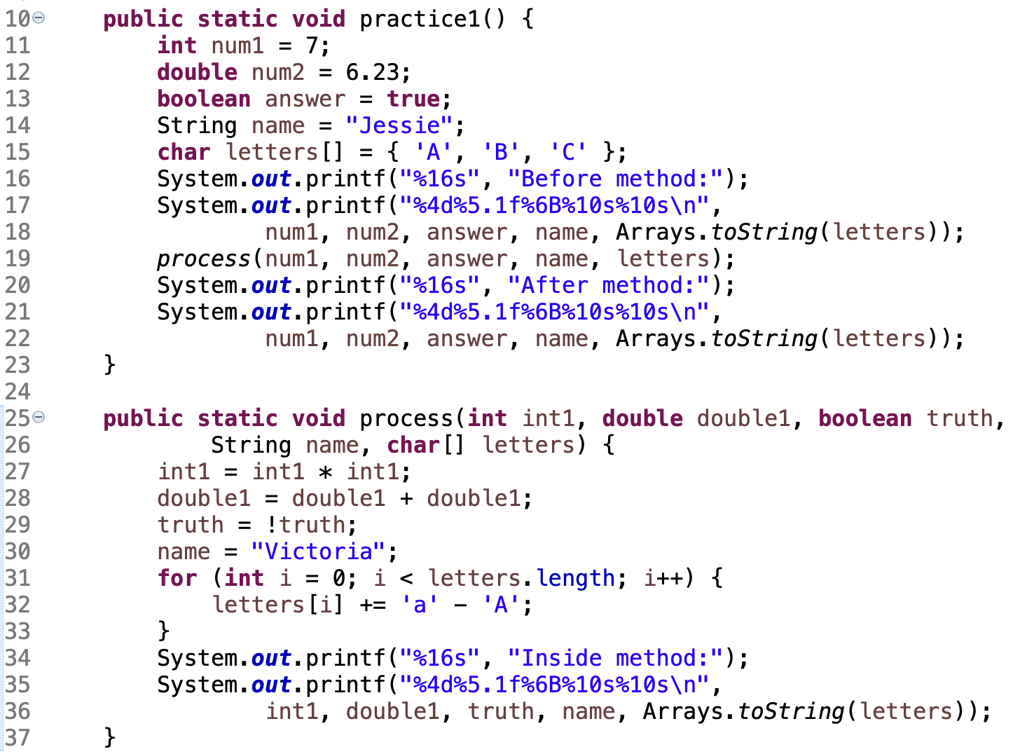
What is the output?
In-Class Practice

Slide 22
Solution

Slide 23
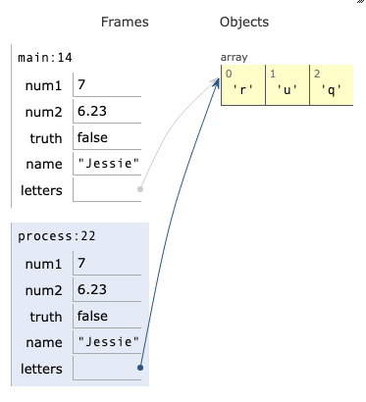
Semantics.java in Python Tutor
Value Semantics for primitive types (copy)
Reference Semantics for objects (pointer)

Slide 24
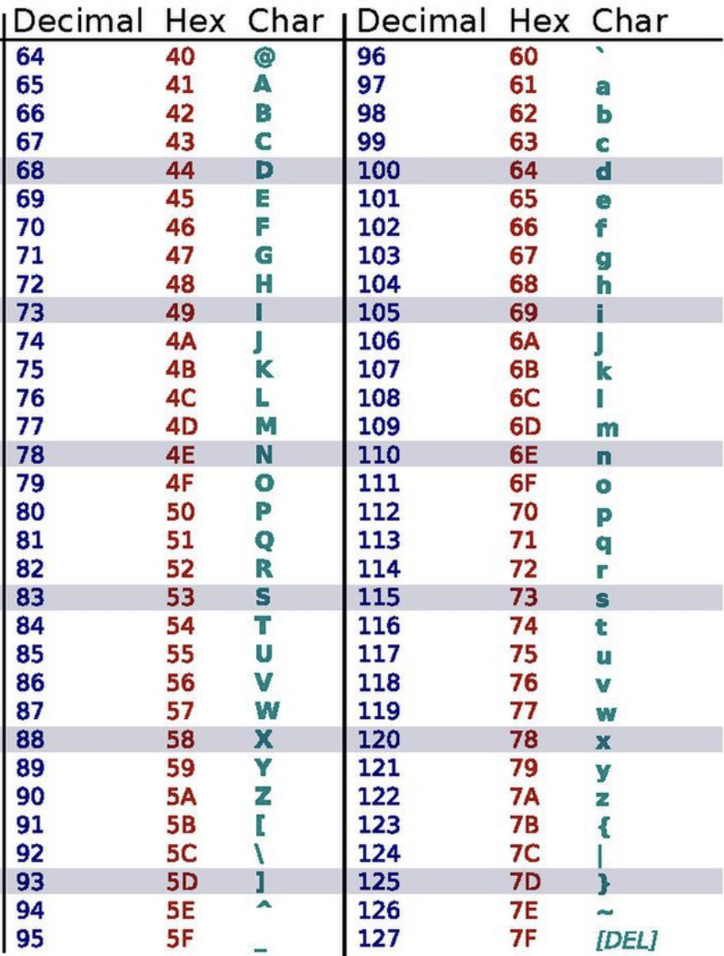
Remember ASCII Table

Slide 25
Demo
Demo 2
What is happening?

Slide 26
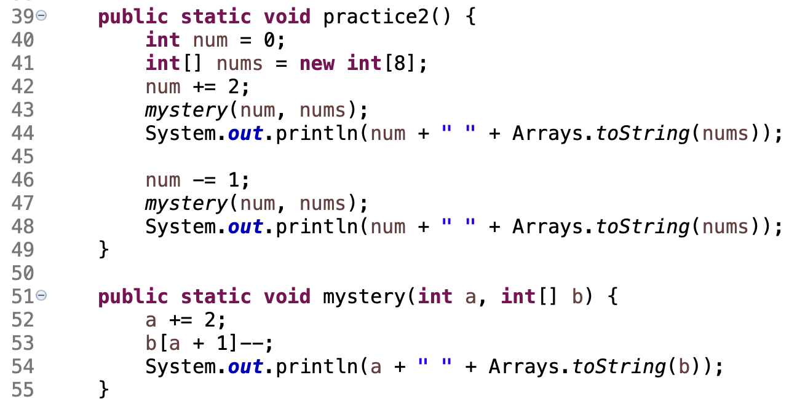
What is the output?
In-Class Practice

Slide 27
Solution

Slide 28
addIntArrays() - Creates and returns a new array that contains ints that are the sum of the ints at the same indices in the original arrays.
For example, parameters:
[1, 7, 9, 4] and [5, 3]
return value:
[6, 10, 9, 4]
In-Class Practice
Design
create new array same size as larger array
copy larger array to new array
loop for each index in smaller array
add value at index in small array to value at index in new array

Slide 29
method: addIntArrays()
Purpose: Creates and returns array that contains ints that are the sum of the ints at the same indices in the original arrays.
Parameters: two integer arrays
Return: new int array
For example, parameters:
[1, 7, 9, 4] and [5, 3]
return value:
[6, 10, 9, 4]
Calling code:
In-Class Practice

Slide 30
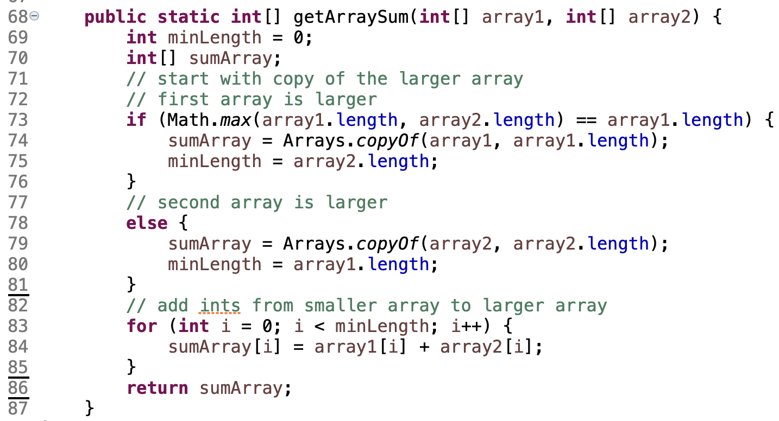
Solution

Slide 31
Remember
You Belong Here
Hi!

